Slide 1

Predicting the Cost of Miami Real Estate
A Presentation for ABC Miami Real Estate Company
Notes:
Hi, In this project I will be taking on the role of a Miami Realtor who is attempting to persuade my Realty Group to invest in an algorithm that will predict the sales price of single family homes in Miami.

Slide 2
Business Question:
How can our Miami real estate company differentiate itself from other real estate companies specializing in the Miami housing market?
Business Solution:
Create a model that will predict housing prices based on customer criteria.
Potential home owners can provide their desired housing requirements to be entered into the model.
Based on resulting price, homes owners can adjust their requirements.
Notes:
The business question is: "How can our Miami real estate company differentiate itself from our competitors who are also specializing in the Miami housing market?“
One way that we could separate ourselves is by creating a model that will predict housing prices based on our customers criteria.

Slide 3
Overview
Review and Clean the Data
Assess Correlations
Prepare the Data
Evaluate Models
Hypertuning
Deploy Predictive Data Frame
Final Recommendations and Considerations
Notes:
These are the steps that we will be taking throughout our presentation. We will do a deep dive into each step as we come to it, but I just wanted to share this overview as a roadmap to our presentation.

Slide 4
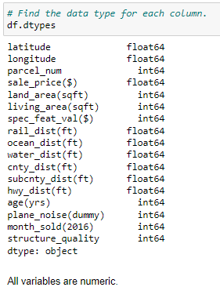
Review and Clean the Data
Utilizing Miami Housing Dataset obtained from Kaggle.
Data set contains details on 13,932 single-family homes sold in 2016 in Miami.
The variables to the right, all numerical, can be found in this dataset.
No null values are present in this dataset.
All 0 values are accurate.
Notes:
The first step is to obtain a housing data set which I have done through Kaggle. This data set has close to 14,000 entries for single-family homes that sold in Miami in 2016. It includes variables that are found in most housing data sets such as the square footage of the home and the age of the home but it also has several distance variables noting the distance in feet that each home is from important city landmarks.
One variable that I do want to call out that has caused some confusion throughout this project is the special features variable. This is a numeric variable that represents the dollar amount that a special feature like a air conditioner would add to a home. For example, if a home has a pool that adds $1,000 to the sale price, $1,000 would be the value for that variable for that entry. If a home has a pool that adds $1,000 plus an air conditioner that adds $500, then $1,500 would be the value for that entry.
After looking through all of the data it turns out that all of my variables are numeric. I also reviewed for null values and for zero values.

Slide 5
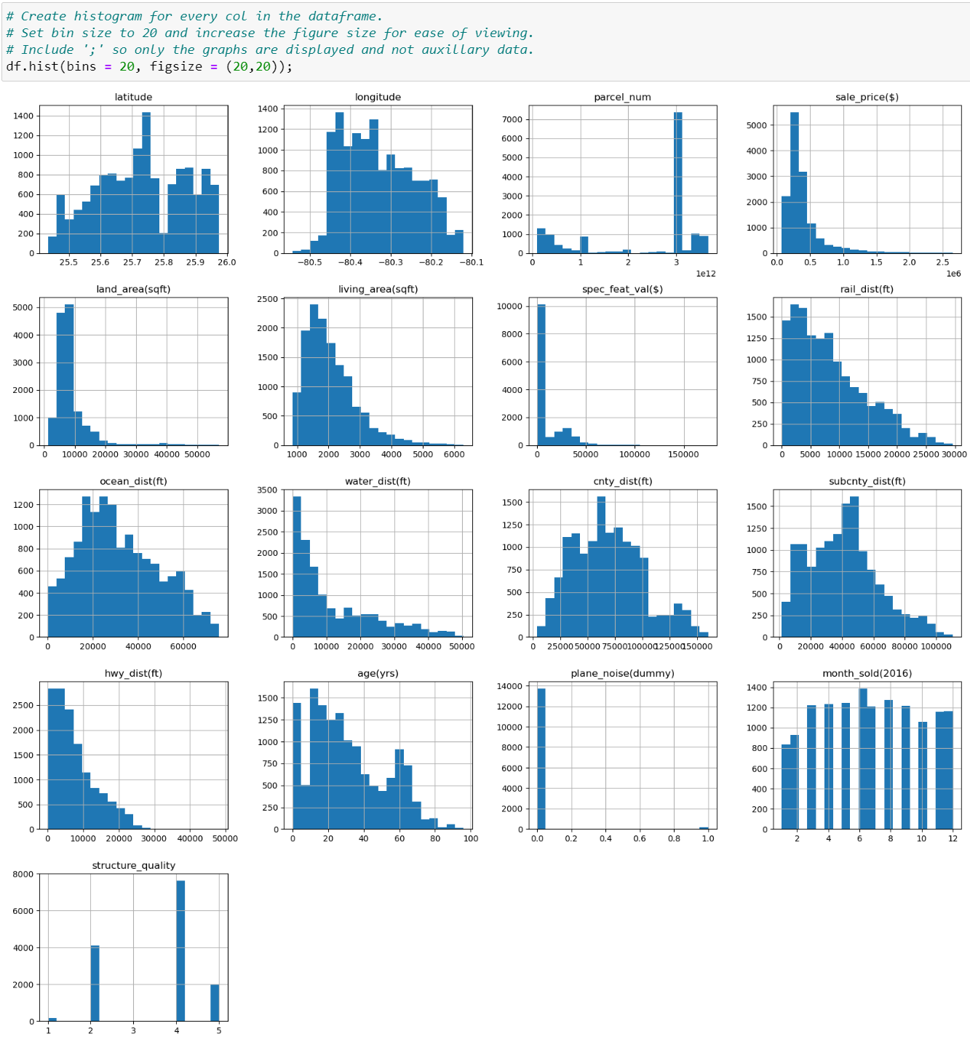
Review and Clean the Data
Histograms were created to better understand the spread and skew of each variable.
Several variables are skewed to the right.
Value of Special Features and Distance to Highway don’t taper off as other variables do.
Notes:
I generated histograms of each variable to determine the spread of the data. There are several variables that have a somewhat normal distribution and there are several variables that appear to be skewed to the right with more values on the lower end and tapering off towards the higher values. However the variables that I have highlighted in yellow, which are the value of special features and the distance in feet to the highway, don't so much as taper off to the right as there appeared to maybe be some outliers on the higher end of the values. I'm going to review these two variables in the next slide with a box and whisker plot.

Slide 6
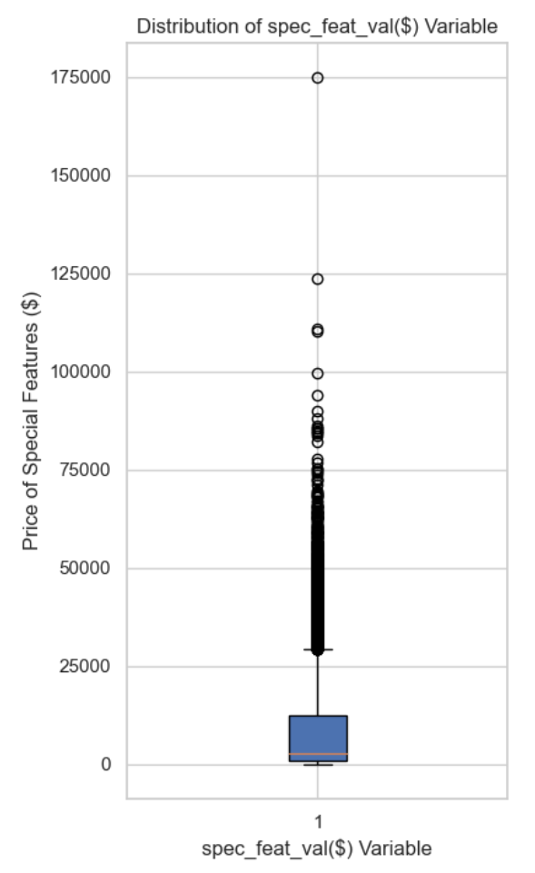
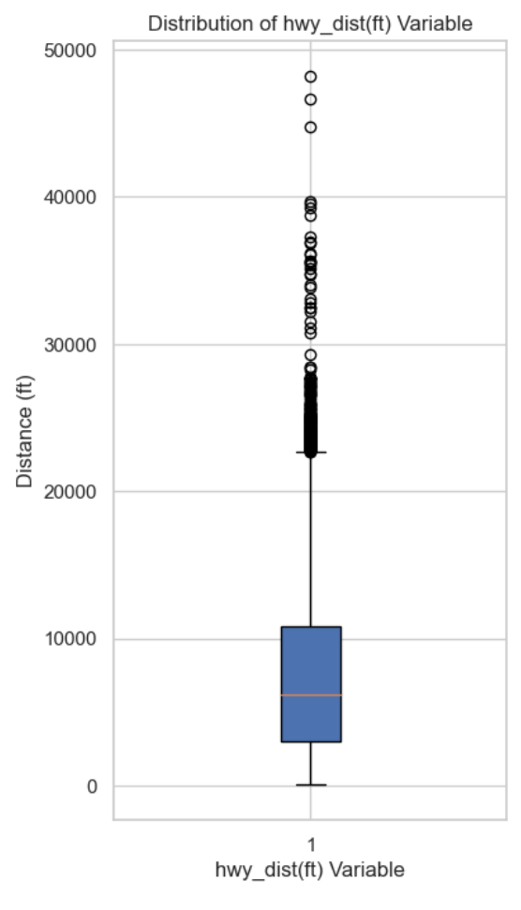
Review and Clean the Data
Notes:
These are the box and whisker plots of the value of special features variable and the distance from the highway variable. You can see that in the special features variable the outliers really differentiate themselves when we get to homes where the value of the special features is above $100,000. With the distance in feet to the highway variable, we start to see more spread in the outliers when a home is greater than 30,000 feet from a highway. I have reviewed these entries and opted to leave them in the dataset. As a company we can determine what our criteria is for outliers and how we’d like to handle them.

Slide 7
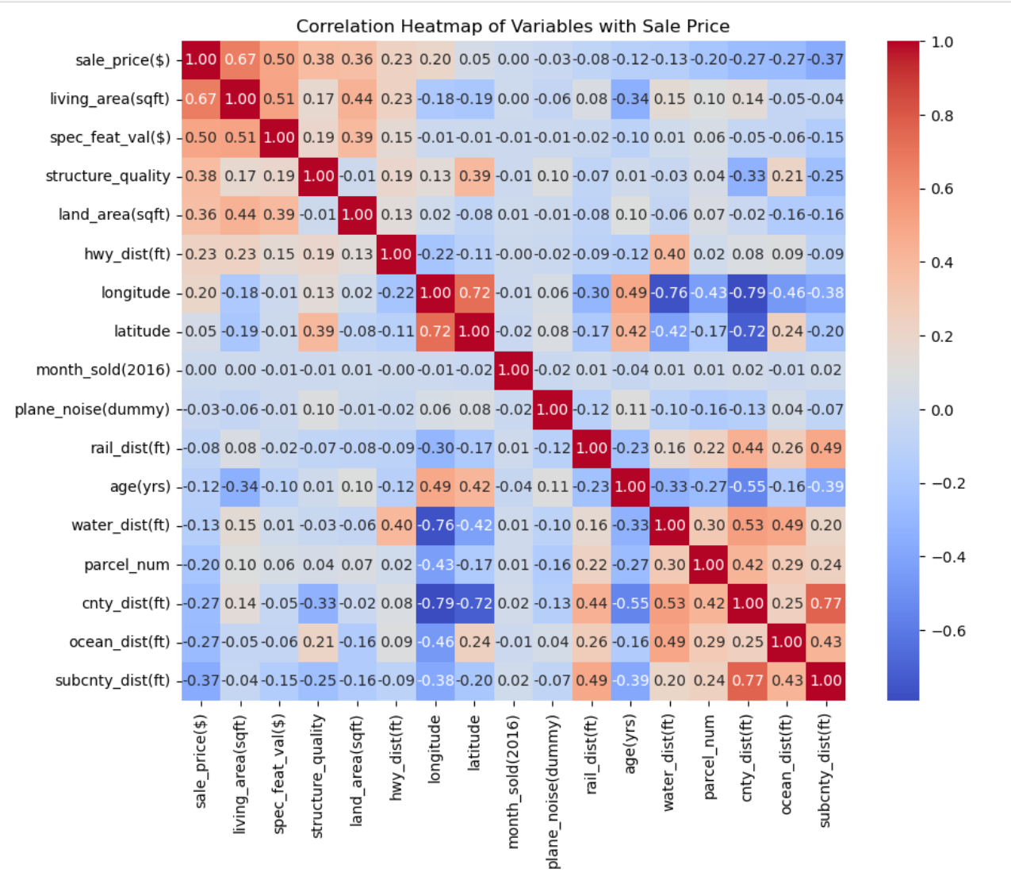
Assess Correlations
To the right is a correlation heatmap detailing the correlations between the variables.
The correlations with the sales price variable are in the first col and organized with the most highly correlated at the top and the variables with the lowest correlation to sales price at the bottom.
Correlation does not imply causation.
Notes:
Here is a correlation heat map. I have organized this so variables with the strongest positive correlation to sale price are the top in a red shade while the variables with the strongest negative correlation to sale price are at the bottom in a blue tone.
Square footage of living area being at the top with a positive .67 correlation tells us that as the square footage and sales price tend to move together in the same direction. So as the square footage increases, the sales price will likely also increase. At the bottom, we see that the distance to the nearest sub center has a negative correlation indicating that these variables tend to move in an opposite direction. as the distance to a substation increases, the sales price decreases. However, the decrease will be at a lesser rate than the increase that we see with square footage of living space because the distance to the sub center only has a -.37 correlation which is relatively weak compared to the square footage of living space which has a .67 correlation.

Slide 8
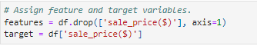
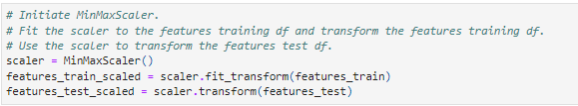
Prepare the Data
Split into target variable (sale price) and feature variables (all other variables).
Split the target and features variables into 80/20 train/test sets.
Initiate scaler
Notes:
We are now ready to prepare our data for a regression model. The first thing we will do is split the data into two sets: One set will have our target variable, which is going to be the sale price as that is what we are trying to predict, and the remaining set will be our features variable, which will have all of the remaining variables in our data set. We will then further divide our data into 80/20 training and testing sets.
The final step in preparing the data is to put it through a min max scaler this is done because we have so many varying units of measurement in our data set. To standardize everything, we have scaled our data so that all the data lies between 0 and 1 using a min max scaler.

Slide 9
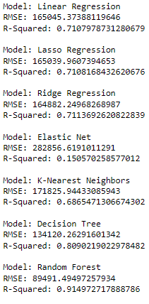
Evaluate Models - Metrics
RMSE – Indicates the average range of errors in predictions
R-Squared - Conveys what percent of variance in my target variable can be explained by the data in the features variable
Notes:
Run the data through a loop of several regression models to determine the best fitting model based on RMSE and R-Squared value.
Based on the above metrics the Decision Tree and Random Forest regression models appear to be the best fits for this data. I'm not surprised that these models have similar metrics as Random Forest is an ensemble model made of several decision trees.

Slide 10
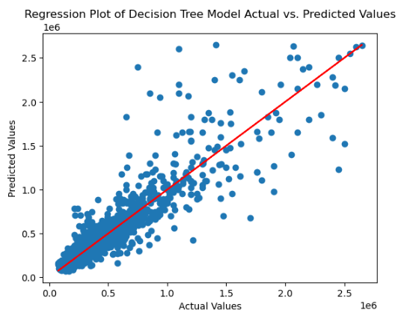
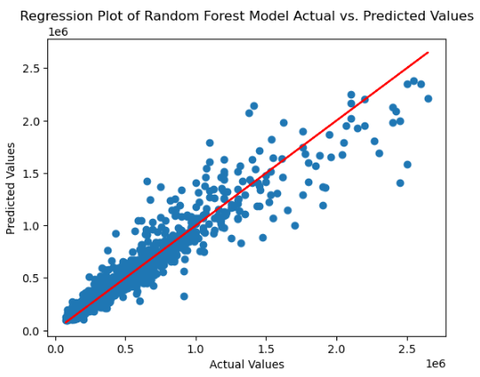
Evaluate Models – Regression Plots
Notes:
These are the regression plots for the decision tree and random forest regression models. The red line in the center is the target line where we want the values to land. The x=axis values are the actual values provided by the target test set and the values on the y-axis are the predicted values generated by our models.
The RFR model has more data points clustered around the target line. This coupled with the RMSE and R2 values that we saw on the previous slide indicates that RFR is the model with which we should proceed.

Slide 11
Hypertuning
Best Hyperparameters
Number of Estimators | 150
Max Depth | None
Min Samples Split | 1
Min Samples Leaf | 2
Number of Estimators – Number of Decision Trees the Random Forest ensemble model will contain.
Max Depth – How many levels each tree will go to
Min Samples Split – Minimum number of observations required to split a node
Min Samples Leaf - Minimum number of observations in each node
Notes:
The final step before deploying the model is to determine the best hyper parameters to provide optimal results. I've chosen to focus on four hyper parameters:
-number of estimators - determines how many decision trees are best for my model in this case it’s 150.
-maximum depth of the tree which was None meaning trees will continue to expand until other criteria are met.
-minimum number of observations required to split each node which was 1
-number of observations in each node which was 2.
I used the negative mean squared error as my scoring metric.

Slide 12
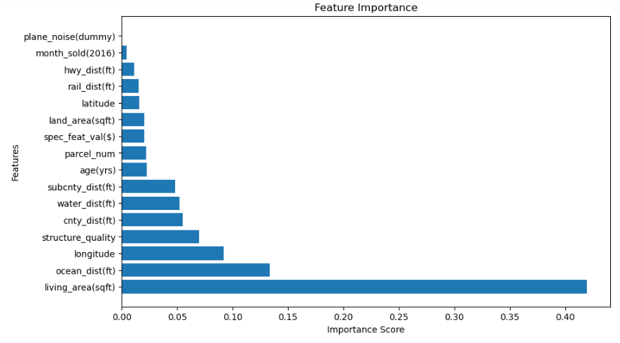
Feature Importance
The square footage of living space is by far the variable with the greatest impact on sale price.
Notes:
This shows how important each feature is when predicting sale price. The square footage of the living area is by far the most important feature. If a client wishes to adjust their predicted sale price, adjusting their desired square footage of living space will have the greatest results in altering sale price. We learned from the correlation heatmap square footage of living space and sale price have a positive correlation so when one variable increases the other variable increases as well and vice versa.

Slide 13
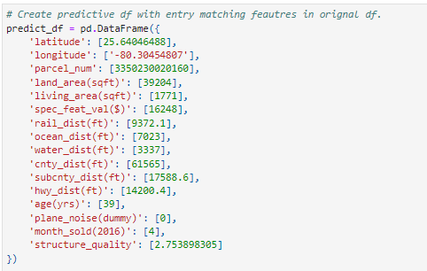
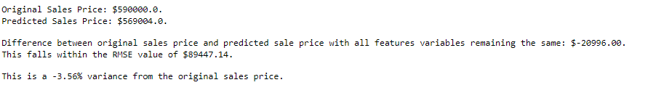
Deploy Predictive Data Frame
Create predictive data frame with variables match the variables in the features set.
The client can fill in their desired criteria. For my example I have mirrored on of the entries in the original data frame.
Below are the results when comparing my predicted sale price to the sale price of the matching entry in the original data frame.
Notes:
The final step, I generated a predictive data frame that had all the same variables as the features set. The customer can place their desired criteria into the data frame, the coding will then use the previously fitted Min/Max scaler to scale the predictive data frame, and then the hyper tuned Random Forest model will generate a predicted sale price for the house described in the predictive data frame.
For my example, I entered data into my predictive data frame which mirrors the data in an entry from the original data frame. The predicted price had a -3.56% variance from the sale price of the matching entry in the original data frame.

Slide 14
Final Recommendations and Considerations
We now have a model that as been fitted to provide our clients an estimated predicted sale price of a home that meets their criteria.
This sets us apart from our competitors.
Model needs to be maintained to incorporate a data set that reflects the housing market and economic environment in which we are attempting to predict.
Notes:
Overall we have developed a model which can predict the sale price of houses in Miami. We’ve even offered an opportunity for client customization, where the can client input their ideal preferences for how far they’d like to live from the ocean, how old they’d like their house to be, how much they want to spend on special features etc. We can then scale and run predictions based on their personalized preferences.
Some things to consider is that housing markets can vary based on location and overall economics. For example, the Miami housing market is not comparable to a housing market in Des Monies, Iowa. Housing prices from 2016 might not apply to the 2024 market. The Realty Group must ensure that they are using a dataset reflective of the market which they are attempting to predict.

Slide 15
References
Asana, T. (2023, February 27). Decision Tree Analysis: 5 Steps to Better Decisions. https://asana.com/resources/decision-tree-analysis
CFI Team. (2023, December 7). Elastic Net. Corporate Finance Institute. https://corporatefinanceinstitute.com/resources/data-science/elastic-net/
Contractor (2021). Miami Housing Dataset. Retrieved December 28, 2023, from Kaggle website: https://www.kaggle.com/datasets/deepcontractor/miami-housing-dataset
Saxena, S. (2023, August 25). A Beginner’s Guide to Random Forest Hyperparameter Tuning. Analytics Vidhya. https://www.analyticsvidhya.com/blog/2020/03/beginners-guide-random-forest-hyperparameter-tuning/
Yasser (2021). Housing Prices Dataset. Retrieved December 4, 2023, from Kaggle website: https://www.kaggle.com/datasets/yasserh/housing-prices-dataset

